Slide 1
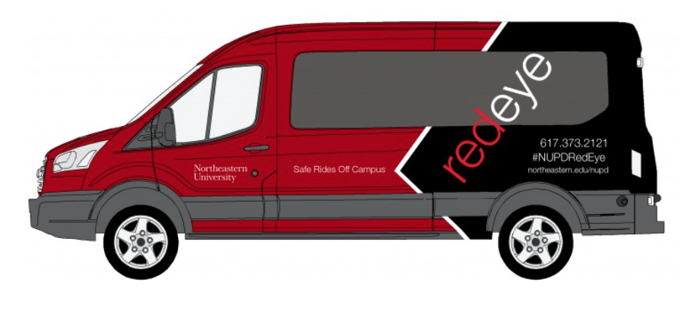

NU RedEye
By Raghuram Parthasarathy
MS in Information Systems
Northeastern University

Slide 2

Project Proposal:
To develop an IOS application to enhance and efficiently utilize NEU’s Red Eye shuttle service .
Inefficiencies in the existing system:
Time delay and resources wastage due to bad route selection.
Student traffic is not tracked/estimated.
Fixed frequency on every day/season.
Difficult for drivers who are new to Boston.
Long wait makes things worse during winter as well as rainy seasons.

Slide 3

Benefits of the new application:
By having a mobile application, student will no longer have to wait in long queues
Efficient route map
Digital record conversion of trip data with feedbacks to the drivers
Operational efficiency of shuttle– control over the frequency based on traffic and resource
Informed and connected travel – facility to track the shuttle
Business Intelligence/Analytics will help to improve the service

Slide 4
Roles in the new system:
Student - Travel in RedEye shuttle.
Shuttle Driver – Verifies student identities and drop students at their respective houses
NUPD – Helps to improve the shuttle service by learning about various ride detail trends

Slide 5
Features Implemented
Google Maps API – Helps to track the location of the next shuttle
Back4app API – All the student details and the history for each trip will be stored in the Northeastern University Police Department (NUPD) database for future references
Binpress Bar Chart API – Shows various trend of student rides which helps NUPD to make the system usage effectively

